Slide 1

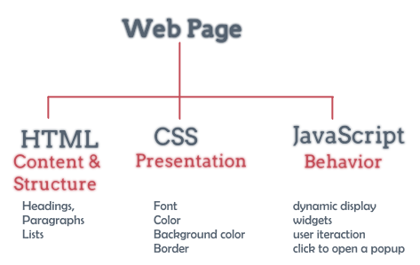
Javascript Part 1

Slide 2
Lesson Objectives
Understanding JavaScript language in web design and programming
Know how to use the rules and syntax of the HTML language to support the design of the interface and design of the web page
Know how to combine JavaScript language, JavaScript functions with HTML tags
Preparing for studying DOM, JSon, AngularJS…

Slide 3
Lesson content
The concept of Script language
Details of how to use JavaScript

Slide 4
1. Concept of Script language
It's a scripting language
Make the website interactive with users
Common scripting languages:
JavaScript (Netscape)
Jscript (Microsoft)
VBScript (Microsoft)

Slide 5
1. Concept of Script language
Client-Side Application:
Execute at Browser(Netscape Navigator, IE,Firefox, chrome,…)
Script at Client-Side (Perform user interactions, change website structure, check user input data, ...)
Server-Side Application:
Running on WebServer (IIS, Netscape Enterprise Server, ...)
Script at Server-Side (database connection, information sharing between web browsers, file system access on server, ...)

Slide 6
1. Concept of Script language
The process of implementing Server-Side application consists of 2 stages:
Create Web pages that contain both Client-Side and Script Server-Side
When the Client browser requests to do so, the server (run-time engine) will execute the Server-side Scipts commands and return the HTML Web page to the browser.

Slide 7
2. Details of how to use JavaScript
JavaScript Concepts
Embed JavaScript in the web
Conventions in JavaScript
Variables and variable declarations
Datatype-Operator
Control structure
Method
String Handling in JavaScript
Some data objects
Object class

Slide 8
JavaScript Concepts
HTML:
HTML is only at the level of information representation
HTML is not yet capable of responding to user events.
Netscape released a scripting language called LiveScript (1995) to perform this feature.
It was later renamed to JavaScipt to take advantage of the popularity of the Java programming language.
Standard Name: ECMAScript, Currently Javascript has version 6 (ES 6)

Slide 9
JavaScript Concepts
JavaScript is a scripting language used to create client-side scripts and server-side scripts.
JavaScript makes it easier to create dynamic and interactive Web pages
Client applications run on a browser such as Internet Explorer, Firefox, Chrome...

Slide 10
JavaScript Concepts
JavaScript can enhance the dynamics and interactivity of web pages.
Provide user interaction
Dynamic content change
Validate data

Slide 11
JavaScript Concepts
Important Note: Java and JavaScript are two completely different languages
Java
Java is an object-oriented programming language
Developed by Sun Microsystems
JavaScript
Javascript Is a WEB scripting language
Developed by Netscape

Slide 12
Embed JavaScript in the web
Direct embedding
<script type=“text/javascript”>
<!--
// Javascript commands
-->
</script>
Embed script from another file
<script src=“file_javascript.js”></script>

Slide 13
Embed JavaScript in the web
<html>
<head>
<script type = “text/javascript">
some statements
</script>
</head>
<body>
<script type="text/javascript">
some statements
</script>
<script src = “file_script.js"> </script>
</body>
</html>

Slide 14
Embed JavaScript in the web
Placed between <head> and </head> tags: the script will execute as soon as the web page is opened.
Placed between <body> and </body> tags: The script in the body is executed while the web page is open (after executing the scripts contained in the <head> section).
Unlimited scripts.

Slide 15
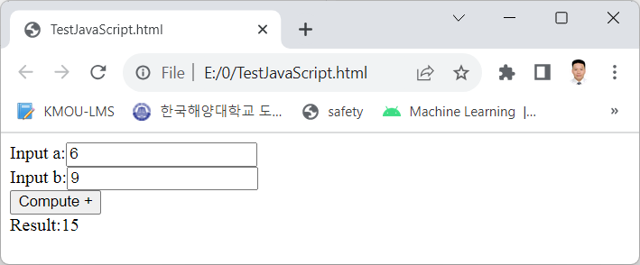
Embed JavaScript in the web
Example 1:
<html>
<head>
<meta charset="utf-8" />
<title></title>
<script type="text/javascript">
function doSum(a, b)
{
document.getElementById("idresult").innerHTML=(eval(a)+eval(b))
}
</script>
</head>
<body>
Input a:<input type="number" id="ida" /><br/>
Input b:<input type="number" id="idb"/><br />
<input type="button" value="Compute +"
onclick="doSum(ida.value, idb.value)"/><br />
Result:<label id="idresult" ></label>
</body>
</html>

Slide 16
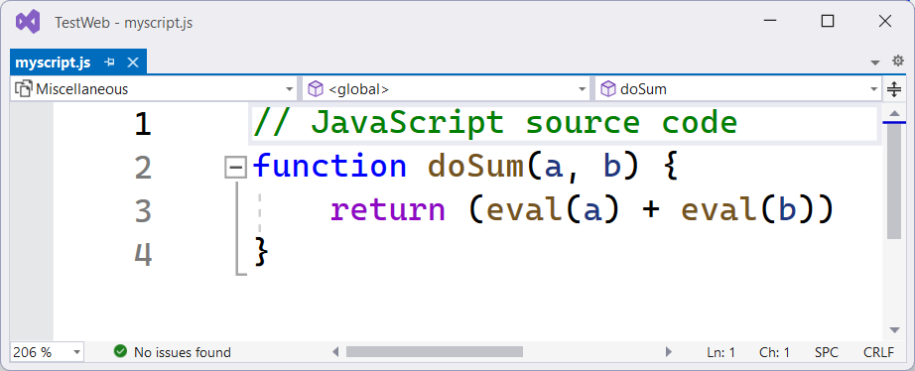
Embed JavaScript in the web
Example 2:
<head>
<meta charset="utf-8" />
<title></title>
<script src="myscript.js"></script>
<script type="text/javascript">
function callDoSum() {
var txtA = document.getElementById("ida")
var txtB = document.getElementById("idb")
var result = doSum(txtA.value, txtB.value)
document.getElementById("idresult").innerHTML = result
}
</script>
</head>
<body>
Input a:<input type="number" id="ida" /><br />
Input b:<input type="number" id="idb" /><br />
<input type="button" value="Compute +" onclick="callDoSum()" /><br />
Result:<label id="idresult"></label>
</body>

Slide 17
Conventions in JavaScript
JavaScript is case sensitive
For example, two variables Java, java are different
JavaScript statements are terminated with a ; or don't need
Regardless of spaces, tabs, and line breaks in the statement.

Slide 18
Conventions in JavaScript
Strings and quotes
Strings in JavaScript are enclosed in single quotes ('') or double quotes ("")
For example :
<input value = ‘He said “JavaScript is good”’>
<input type=“button”value=“Click Me!” onclick = “alert(‘Hello’);”
Comment: according to the following note syntax
// single comment
/* multiple comment
multiple comment */

Slide 19
Conventions in JavaScript
Variable and function:
Starting with Characters (A..Z, a..z), _, $
Does not start with a digit (0..9)
No spaces in variables or functions
Do not name the same keyword

Slide 20
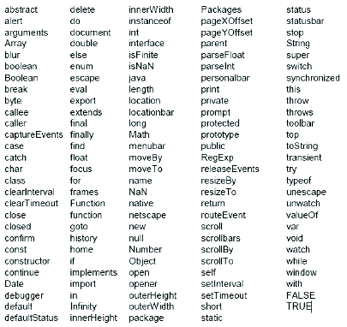
Conventions in JavaScript
Keywords should not duplicate name

Slide 21
Variables and variable declarations
Each variable will have a representative name
A variable is a "container" of the information you want to store
Information and data of the variable may change during the execution of the command
Use a variable name to refer to that variable's data

Slide 22
Variables and variable declarations
Use the var keyword before the variable name
Variables can be initialized before or not
var strname = value ;
Variable name : strname
The value assigned to the variable : value
For example:
var strname = “Hello Word!”;

Slide 23
Variables and variable declarations
For example:
var x ;
var y, sum ;
var x = 1, y = -10, sum = 0;
Variables in JavaScript can store values of any data type
Variables in JavaScript may not need to be declared :
For example :
x = 5
x = x + 2
alert(x)

Slide 24
Data types
Data types | For example | Description
Object | var listBooks = new Array(10) ; | using the new to allocate memory for object
String | “Good luck.” “10” | Can contain Unicode string and Empty string ""
Number | 0.066218 , 12 | According to IEEE 754 standard
boolean | true / false
undefined | var myVariable ; | myVariable = undefined
null | connection.Close(); | connection = null
function | var add = new function("x", "y", "return(x+y)"); add(2, 3); | functionName = new function( [argname1, [... argnameN,]] body );

Slide 25
Data types
Integer type
Integers can be represented in decimal (base 10), hexadecimal (base 16), and octal (base 8)
A decimal integer digit consists of a sequence of numbers without a leading zero.
A leading zero in an integer digit indicates that it is represented in octal
If leading an integer digit is 0x (or 0X) indicating it is represented in hexadecimal

Slide 26
Data types
Integer type
Decimal integers include numbers from 0 to 9.
Hexadecimal integers can include the numbers 0 through 9 and the letters a through f and A through F.
The octal integer includes the numbers 0 through 7.
Octal integers are deprecated and have been dropped from ECMA-262 edition 3.
JavaScript still supports octal integers for compatibility with earlier versions.

Slide 27
Data types
Integer type
Integer example:
42
0xFFF
-345

Slide 28
Data types
Real number type (floating point number type)
The real number type can have the following components:
Integer decimal part
One decimal point (".")
Remainder (which is another decimal)
Index number

Slide 29
Data types
Real number type (floating point number type)
Where the exponent is a letter "e" or "E", followed by an integer, possibly marked (preceded by a "+" or "-").
A floating point number must contain at least one number and one decimal point, or “e” (or “E”).

Slide 30
Data types
Real number type (floating point number type)
Examples of real numbers :
3.114
-3.1E12
.1e12
2E-12

Slide 31
Data types
Logical (or Boolean) type
Logical type is used to indicate two conditions: true or false.
The value domain of this type has only two values:
true.
false.

Slide 32
Data types
String Type
A literal string consisting of zero or more characters enclosed in double quotes ("") or single quotes ('').
A string must be delimited by quotes of the same type, i.e. both single quotes or double quotes

Slide 33
Data types
String type
Examples of strings:
“Hello”
‘Error!’
“12345”
You can call any method of the String object on a string value - JavaScript automatically converts the string to a temporary String object, then it calls the requested method, which it then discards temporary String object.

Slide 34
Data types
String Type
When using a string, in addition to regular characters, we can also insert special characters into the string. Special characters will perform a specific task.
For example : “one line \n another line”
In the above example, the sign "\" combined with the character "n" will mean line-to-line. So when executing the above command, the result will be displayed as:
one line
another line

Slide 35
Data types
String
character Meaning
\b Backspace
\f Form feed
\n new line
\r Move the cursor to the beginning of the current line
\t one Tab space

Slide 36
Data types
String type
In addition, some other special characters can be inserted in a string by preceded it with a backslash (\).
This is considered an escape character.
The backslash is used to ignore the meaning of the character after it.
For example, if you want to display the characters ', " or \ in the string, you must put the backslash in front, that is \', \" and \\.

Slide 37
Data types
null
The null type has only one value: null.
Null means no data, it functions as a placeholder in a variable in the sense that there is nothing useful there.
The number 0 or an empty string or null are different values

Slide 38
Operator
Math operators
Assignment operator
Comparison operator
Logical operator
String concatenation operator

Slide 39
Math operators
Operator | Description | Example | Result
+ | Addition | x=2 x+2 | 4
- | Subtraction | x=2 5-x | 3
* | Multiplication | x=4 x*5 | 20
/ | Division | 15/5, 5/2 | 3 , 2.5
% | Modulus (division remainder) | 5%2, 10%8, 10%2 | 1, 2, 0
++ | Increment | x=5 x++ | x=6
-- | Decrement | x=5 x-- | x=4

Slide 40
Assignment operator
Operator | Example | Is The Same As
= | x=y | x=y
+= | x+=y | x=x+y
-= | x-=y | x=x-y
*= | x*=y | x=x*y
/= | x/=y | x=x/y
%= | x%=y | x=x%y

Slide 41
Comparison operator
Operator | Description | Example
== | is equal to | 5==8 returns false
!= | is not equal | 5!=8 returns true
> | is greater than | 5>8 returns false
< | is less than | 5<8 returns true
>= | is greater than or equal to | 5>=8 returns false
<= | is less than or equal to | 5<=8 returns true

Slide 42
Logical operator
Operator | Description | Example
&& | and | x=6, y=3 (x < 10 && y > 1) returns true
|| | or | x=6, y=3 (x==5 || y==5) returns false
! | not | x=6, y=3 !(x==y) returns true
?: | If .. Else | x=6, y=3 x>y ? return x : return y

Slide 43
String concatenation operator
When we need to concatenate two strings, we use the plus operator "+":
We consider the following example:
txt1 = “What a very”
txt2 = “nice day!”
txt3 = txt1 + txt2
Then txt3 has the value: "What a verynice day!"
To add a space between two values, we append a string that is a space character between

Slide 44
String concatenation operator
txt1 = "What a very"
txt2 = "nice day!"
txt3 = txt1 + " " + txt2
or
txt1 = "What a very "
txt2 = "nice day!"
txt3 = txt1 + txt2

Slide 45
Control structure
Conditional statements: if else, switch
Loop commands: for, while, do…while

Slide 46
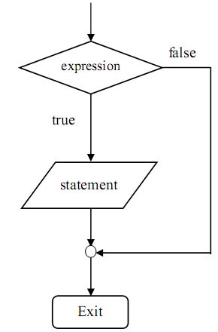
If condition
For example
<script type="text/javascript">
//If the time on your browser is less than 10,
//you will get a "Good morning" greeting.
var d=new Date() ;
var time=d.getHours() ;
if (time<10) { document.write("<b>Good morning</b>") ;
}
</script>
if (<expression> )
{
<statement>
}

Slide 47
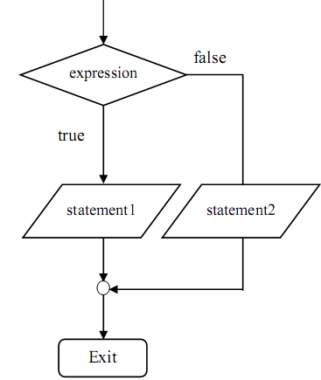
If…else
For example :
<script type="text/javascript">
var x = 5, y = 6, z
if(x == 5) {
if(y == 6) z = 17
}
else
z = 20
</script>
if (< expression > )
{
< statement 1>
}
else
{
< statement 2>
}

Slide 48
switch
switch (< variable to check >)
{
case <value 1>:
<statement 1>
break;
case < value 2>:
< statement 2>
break;
…
default:
< statements if none of the above >
break;
}

Slide 49
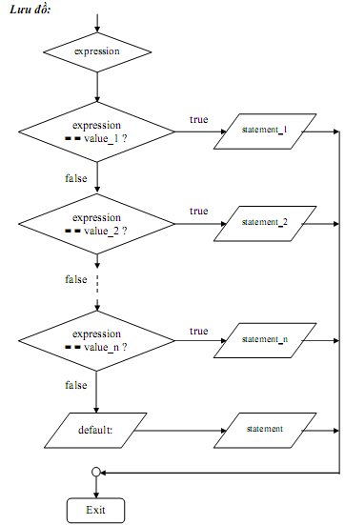
switch

Slide 50
switch
Example 1 :
<script type="text/javascript">
var d=new Date();
theDay=d.getDay();
switch (theDay)
{
case 5: document.write(“Friday"); break ;
case 6: document.write(“Saturday"); break ;
case 0: document.write(“Sunday“); break ;
default: document.write("I'm looking forward to this weekend!") ;
}
</script>
Example 2 :
var diem = “G”;
switch(diem)
{
case “Y”:document.write(“Yếu");break;
case “TB”:
document.write(“Trungbình");break;
case “K”:document.write(“Khá");break;
case “G”:document.write(“Giỏi");break;
default :document.write(“Xuấtsắc");
}

Slide 51
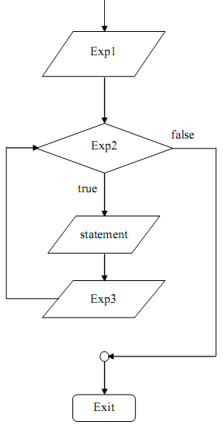
For loop
Syntax :
for (Exp1; Exp2; Exp3)
statement
Meaning:
Exp1 is the initialization expression to be executed.
Exp2 is the conditional expression
Exp3 is the iterative control expression

Slide 52
For loop
n=5, gt=1
step 1) i=1, check i<=n⬄i<=5➔TRUE, do the body for:
gt=gt*i=1*1=1
step 2) i++➔i=i+1=1+1=2,
check i<=n ⬄2<=5➔ TRUE, do the body for
gt=gt*i=1*2=2
step 3) i++➔i=i+1=2+1=3
check i<=n ⬄3<=5➔ TRUE, do the body for :
gt=gt*i=2*3=6
step 4) i++➔i=i+1=3+1=4
check i<=n ⬄4 <=5➔ TRUE, do the body for :
gt=gt*i=6*4=24
step 5) i++➔i=i+1=4+1=5
check i<=n⬄5<=5➔ TRUE, do the body for :
gt=gt*i=24*5=120
step 6) i++➔i=i+1=5+1=6
check i<=n ⬄6<=5➔FALSE➔END for
For example :
var gt=1
var n = 5
for(var i=1; i<=n; i++)
{
gt=gt* i
}
➔gt=?

Slide 53
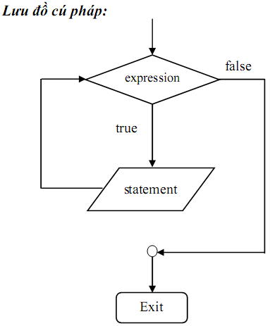
while loop
Syntax:
while(expression)
statement
Meaning:
Step 1: Expression is evaluated
Step 2: If the result is true, the statement executes and returns to Step 1
Step 3: If the result is false then exit the while loop.
➔while loop may not execute statement at all

Slide 54
while loop
n=5, gt=1, i=1
Step 1: Check i<=n⬄1<=5➔TRUE➔do the body while:
gt=gt*i=1*1=1
i++➔i=i+1=1+1=2
Step 2: Check i<=n⬄2<=5➔ TRUE➔do the body while:
gt=gt*i=1*2=2
i++➔i=i+1= 2+1=3
Step 3: Check i<=n ⬄3 <=5➔ TRUE➔do the body while:
gt=gt*i=2*3=6
i++➔i=i+1=3+1=4
Step 4: Check i<=n⬄4<=5➔ TRUE➔do the body while:
gt=gt*i=6*4=24
i++➔i=i+1=4+1=5
Step 5: Check i<=n⬄5<=5➔ TRUE➔do the body while:
gt=gt*i=24*5=120
i+=➔i=i+1=5+1=6
Step 6: Check i<=n⬄6<=5➔FALSE➔END while
For example
n = 5
gt=1
i = 1
while (i <= n)
{
gt =gt* i
i++
}
➔gt?

Slide 55
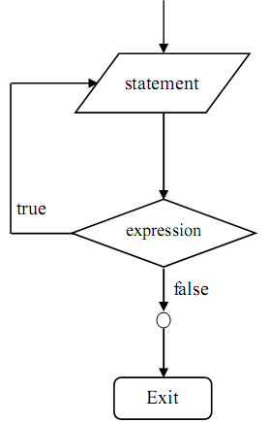
do…while loop
Syntax:
do {
statement
}while(expression)
Meaning :
Step 1: Statement is done
Step 2: Expression is evaluated.
If expression is true then go back to step 1
If expression is false then exit the loop.
➔do...while loop maybe statement will be executed at least once

Slide 56
do…while loop
n=5; gt=1, i=1
Step 1: gt=gt*i=1*1=1
i++➔i=i+1=1+1=2
Check i<=n ⬄2<=5➔TRUE
Step 2: gt=gt*i=1*2=2
i++➔i=i+1=2+1=3
Check i<=n ⬄3<=5➔ TRUE
Step 3: gt=gt*i=2*3=6
i++➔i=i+1=3+1=4
Check i<=n ⬄4<=5➔ TRUE
Step 4: gt=gt*i=6*4=24
i++➔i=i+1=4+1=5
Check i<=n⬄5<=5➔ TRUE
Step 5: gt=gt*i=24*5=120
i++➔i=i+1=5+1=6
Check i<=n ⬄6<=5➔False➔END do while
Example
n = 5
i = 1
gt=1
do
{
gt =gt* i
i++
} while (i<=n)
➔gt?

Slide 57
Functions in Javascript
Declare a function or method
Each user-defined function or method begins with the keyword function .
Parameters passed to a function or method do not need to declare a data type

Slide 58
Functions in Javascript
How to define a function?:
Functions with parameters :
function FunctionX(parameter 1, parameter 2,..)
{
// body of function
}
- Function without parameters
function FunctionX()
{
// body of function
}

Slide 59
Functions in Javascript
- The function returns the value :
function FunctionX(parameter 1, parameter 2,..)
{
// Body of function
return (value)
}

Slide 60
Functions in Javascript
- Example of creating a function in JavaScript :
Function definition :
function Sum(x, y)
{
s = x + y
return s;
}
Calling the function :
var x = Sum(30, 40)

Slide 61
Some built-in functions in Javascript
eval function
isNaN function
parseInt and parseFloat function
Number and String function

Slide 62
Some built-in functions in Javascript
eval function
Used to evaluate a string without referring to any specific object.
Syntax:
eval(string)
Where string is the string to be evaluated. This string can be a JavaScript expression, a statement, or a group of statements.
The expression can include variables and properties of an object.

Slide 63
Some built-in functions in Javascript
eval function
If the string represents an expression, the eval function evaluates the expression.
If the argument represents one or more JavaScript statements, the eval function executes these statements.
Do not use the eval function to evaluate an arithmetic expression; JavaScript evaluates arithmetic expressions automatically.

Slide 64
Some built-in functions in Javascript
isNaN function
The isNaN function evaluates an argument to determine if it is “NaN” (Not a Number).
Syntax:
isNaN(testValue)
With testValue being the value you want to evaluate.
The parseInt and parseFloat functions return “NaN” when they evaluate to a value that is not a number.
The isNaN function returns true if it is passed the value "NaN" and false otherwise.

Slide 65
Some built-in functions in Javascript
The following code evaluates floatValue to determine if it is a number and then calls an appropriate procedure:
var floatValue = parseFloat (toFloat)
if (isNaN (floatValue)) {
notFloat()
}
else {
isFloat()
}

Slide 66
Some built-in functions in Javascript
Number converts object to number
var x1 = true; var x2 = false; var x3 = new Date(); var x4 = "999"; var x5 = "999 888"; var n = Number(x1) + "<br>" + Number(x2) + "<br>" + Number(x3) + "<br>" + Number(x4) + "<br>" + Number(x5);
Results:
1 0 1382704503079 999 NaN

Slide 67
Next lesson
String Handling in JavaScript
Some data objects
Class and Object (OOP)

Slide 68


Hey! Coding is easy!
END

